Slide 1
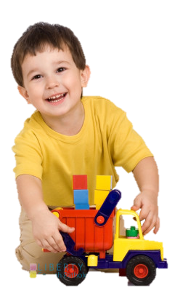
The Power of Play
Parent Workshop
Dr Gillian O’Shea
Educational Psychologist
Notes:
Introduction – who I am
What the purpose of today’s session is

Slide 2
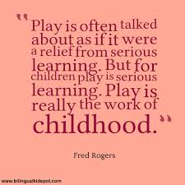
Notes:
Play is what children and young people do when they follow their own ideas and interests, in their own way, and for their own reasons.’
Children’s right to play is a human right
On 1 February 2013 the United Nations Committee on the Rights of the Child adopted a General Comment that clarifies for governments worldwide the meaning and importance of Article 31 of the Convention on the Right of the Child.

Slide 3
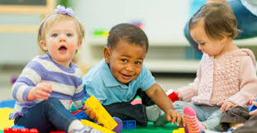
The power of play
Social and emotional wellbeing comes from children feeling safe, secure and valued. The sense of wellbeing frees children to explore and learn.
They learn ways to understand the world, knowing that they can get help and support when they need it. They gradually learn to identify and express their feelings and gain skills and understandings about relating to others.
Much of what children learn about making relationships and managing emotions occurs through play.
Notes:
when children feel safe and secure they can focus on exploration and learning.
Play enables children to express feelings and practise roles. Through play children also learn to negotiate the give and take of relationships with others.

Slide 4
Play helps children to………
increase their self-awareness, self-esteem, and self-respect
improve and maintain their physical and mental health
give them the opportunity to mix with other children
allow them to increase their confidence through developing new skills
promote their imagination, independence and creativity
offer opportunities for children of all abilities and backgrounds to play together
provide opportunities for developing social skills and learning
build resilience through risk taking and challenge, problem solving, and dealing with new and novel situations
provide opportunities to learn about their environment and the wider community.

Slide 5
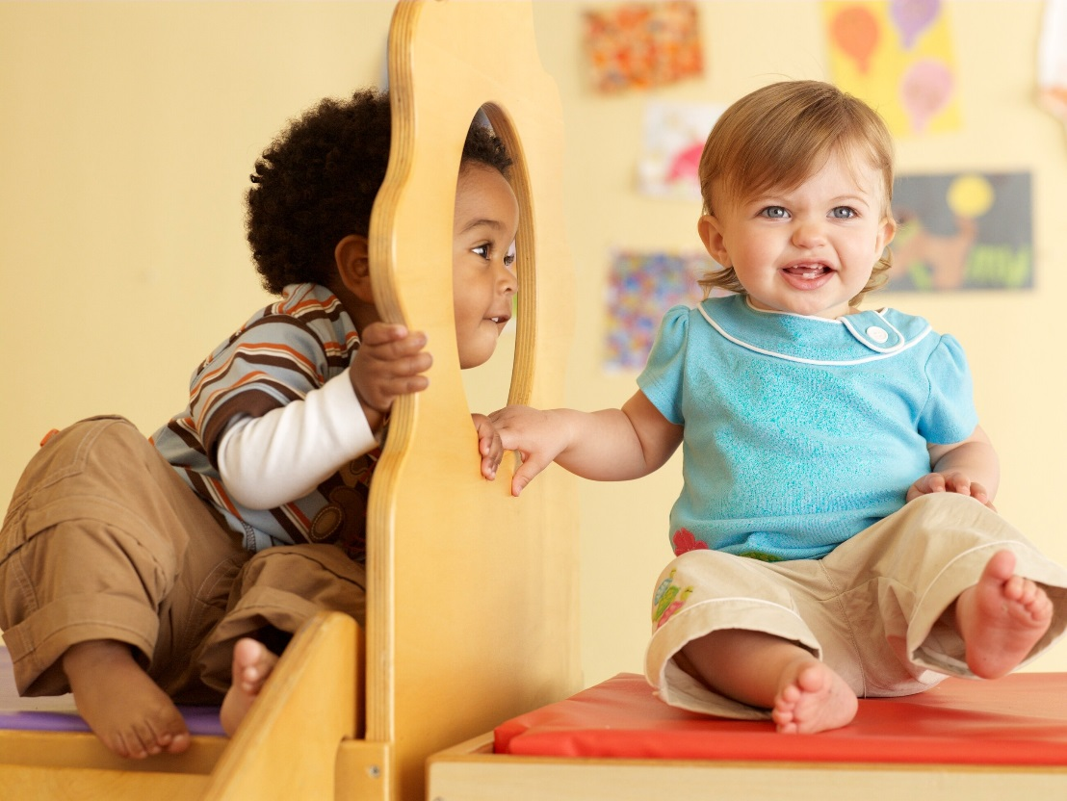
Play and developing a sense of self
Play provides opportunities for children to have power over what they do as well as what and how they learn.
Children are reliant on caregivers and their lives are often organised around an adult’s schedule.
In play, children have more opportunity to make decisions. This is important for their developing sense of self as it builds feelings of self efficacy, competence and confidence.

Slide 6
Play is a way that children can work through and resolve problems
Young children often do not have the language to really express their feelings but they can do it through play. As children grow and learn, their play becomes a way of expressing themselves. These ways of personal expression can help them to cope with feelings all their lives.
For example, a child whose family has separated may feel very anxious about what is going to happen to them. These feelings and possibilities can be explored through play. The child can practise having two homes set-up with two houses and different dolls. The same applies to children who have moved house, as distance can be a difficult concept for young children to understand.

Slide 7
Parten’s categories of social participation
Category | Description
Unoccupied | Child is not engaged in any activity
Onlooker | Child is just watching others, not joining in
Solitary | Child plays alone, away from others
Parallel | Child plays near others at an activity, doing similar things e.g. playing independently at the sand tray
Associative | Child interacts with others at an activity, doing similar things, e.g. each adding building blocks to the same tower
Cooperative | Child interacts with others in complementary ways e.g. one child gets blocks and hands them to another child, who builds the tower
Notes:
Development of play skills
Parallel play is a form of play in which children play adjacent to each other, but do not try to influence one another's behaviour. Children usually play alone during parallel play but are interested in what other children are doing.
As children get older they become involved in play that involves more interaction
As children grow and develop, they move through six stages of play, though they may not progress in a linear fashion. Instead, their progression may involve engaging in different stages at different times depending on the physical environment and their individual temperament.
Unoccupied Play (Birth-3 Months)
Spectator/Onlooker Behavior (2 Years)
Solitary Play (Birth-2 Years)
Parallel Play (2+ Years)
Associate Play (3-4 Years)
Cooperative Play (4+ years)

Slide 8
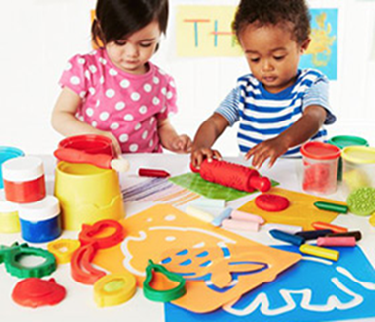
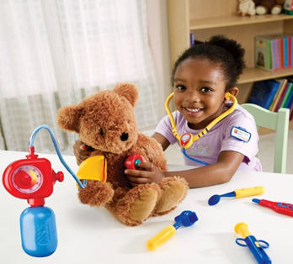
There are many different types of play. Can you think of any?

Slide 9
Types of Play | Importance
Exploratory Play | The kind of play when children use their touch, smell and taste senses to explore and learn about the texture and function of the world around them.
Pretend Play | Children learn to take turns, cooperate with others and work on language development.
Competitive Play | Helps children learn about rules and turn-taking and how to function as part of a team. Develops language skills.
Physical/Active Play | This helps children develop gross (large movement) and fine (small movement) motor skills.
Constructive Play | Teaches children how to build, manipulate and fit things together. This helps develop their motor and cognitive skills.
Notes:
Messy play, sand and water play, play-dough,
In pretend play, children may act out real-life situations. Development of language and narrative skills. Using their imagination.
Children follow or create rules to reach a shared objective in a game.
Concepts like turn taking are reinforced by this type of play. At young age children play by their own very flexible rules.
Language skills are a key element of this type of play, as children explain, question and negotiate the rules.
Young children may do pretend actions first with themselves, then with a doll or teddy e.g. pretending to go to sleep and later carrying out this action with a teddy.
The caregiver has an important role, supporting the play a lot at first by suggesting and demonstrating actions. For example, the caregiver might ‘give teddy a bath’ and then hand the teddy to the child.
Children in such play practice their relationships with others and this is essential if a child is to fully understand that other people are separate beings who have minds of their own (‘Theory of mind’)
This realisation usually prompts the child to consider what other people may feel and to adjust his or her behaviour accordingly.
Constructive play – lego, blocks, junk modelling, meccano

Slide 10
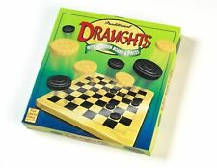
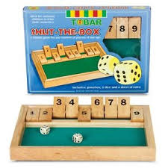
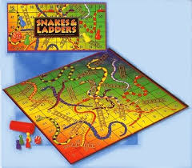
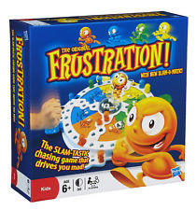
Notes:
Choosing the Right Game at Every Age While in the long run we need to teach values, ethics, academic skills, and the importance of playing by the rules, in the early years the primary goals are helping your child become more self-confident and ambitious and to enjoy playing with others. If you're playing with more than one child, divide the family into teams, giving each player a job he can do well: A younger child may be responsible for rolling the dice (which he considers important, since that is where the luck comes from), and an older child the job of sorting the Monopoly money.
As children approach 5, they have more sophisticated thinking skills and can begin to incorporate and exercise their number, letter, and word knowledge in literacy-based games. By 6, children may prefer more cognitively challenging games like checkers, which require and help develop planning, strategy, persistence, and critical thinking skills.
board games can teach important social skills, such as communicating verbally, sharing, waiting, taking turns, and enjoying interaction with others.
Board games can foster the ability to focus, and lengthen your child's attention span by encouraging the completion of an exciting, enjoyable game
Board games (particularly those with numbers and linear number sequences) lead to improvements in numeracy and mathematical ability
Increased concentration skills
Problem solving (draughts)

Slide 11
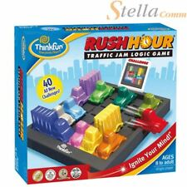
Notes:
For children of 6 plus
Problem solving, reasoning, logic skills

Slide 12
Questions
?
?
?
?

